Slide 1
Temporal Compression of Digital Holograms using the ffmpeg standard
Chris Mullen 10387763
Supervisor: Thomas J. Naughton

Slide 2
Goals Of My Project
Find a method to compress a collection of holograms with good reduction in storage size and acceptable level of quality reduction using variants of the ffmpeg standard.
Previous work in this area relates to single image compression (intra-frame).
Apply inter-frame compression to digital holograms whereby similar frames are compressed together.
To develop a codec for holographic videos as none exist currently.

Slide 3
Overview Of Background
A real-world 3D object can be stored digitally as a complex valued matrix, amplitude and phase (digital hologram).
However, hologram images are difficult to compress, so when applied to video, higher compression rates become critical for digital holographic Videos to be a viable form of media.

Slide 4
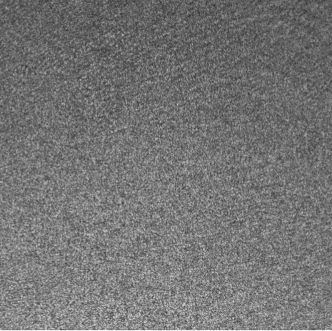
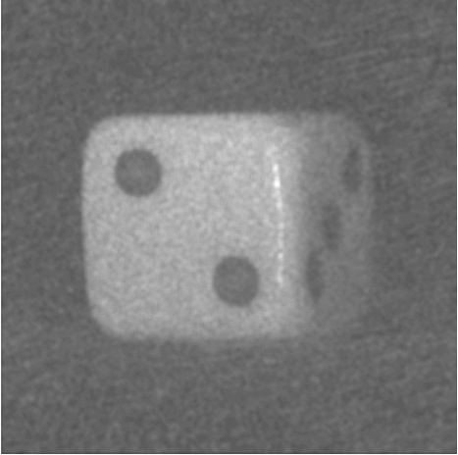
digital holograms are difficult to compress effectively due to a large amount of noise, hologram images are also very large. (2000x2000 pixel hologram =~60MB).
Existing inter-frame compression algorithms are macro-block based which I have shown to perform poorly with noisy data.

Slide 5
Progress
Due to the large open source nature of ffmpeg, some advanced features are poorly documented (motion estimation), so I performed extensive experimentation on the ffmpeg's ability to compress noisy hologram data.
Examined the results of these experiments to observe areas in ffmpeg where improvements could be made.
Developed a pre/post processing wrapper function to improve on ffmpeg's weaknesses.
Subjected my own solution to the same experimentation used to test ffmpeg originally and compared results.

Slide 6
Performance Comparison 1
Two noise frames created from random values.
A redundant block is placed in each frame at varying distances.
File size is measured to find the point where redundancy is no longer recognised.

Slide 7
Performance Comparison 2
Two noise frames created from random values (As before).
A redundant block is placed in each frame in the same location.
Random pixel errors are added to the block in one of the frames.
File size is measured to find the point where redundancy is no longer recognised.

Slide 8
Performance Comparison 3
This test combines the two previous tests.
Pixel errors are added to the block as before, But a pixel shift of 8 is applied to one of the blocks.
File size is measured to find the point where redundancy is no longer recognised.

Slide 9
Problems Encountered
The experimentation stage took longer than expected due to the largely automatic process of motion estimation.
Certain features of ffmpeg were poorly documented which slowed my progress as more experimentation needed to be done to examine ffmpeg’s limitations.
The final solution underwent several revisions to bring it up to an high enough standard.

Slide 10
Future Work
My solution prototype can be optimized further and automated to be used with a larger number of frames in a digital holographic video.
Due to the higher amount of detail recognised by my algorithm (as opposed to macro-block based algorithms), it has applications in pattern recognition and production quality High-definition digital hologram video formats.

